Slide 1
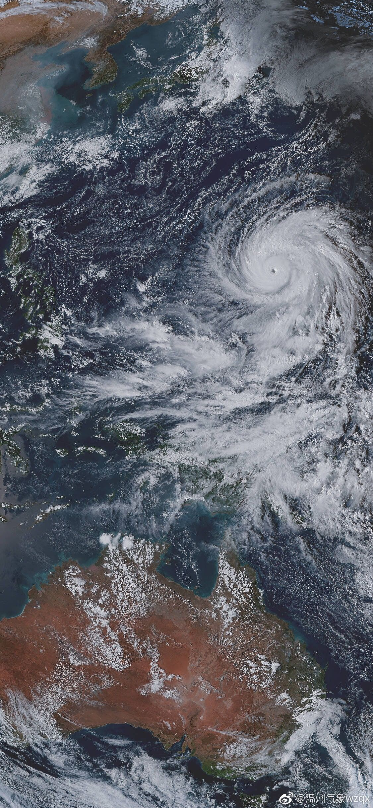
EDA to Typhoon Mitigation and Response Framework (TMRF)
Integration of Global Plans for a Better Typhoon Disaster Response
Presented by:
TEAM TYPHOON ANALYST
Alvaro, Gabriel Edrian
Palis, John Arthur
Alangilan, Christine Joy
Guerra, Marian

Slide 2
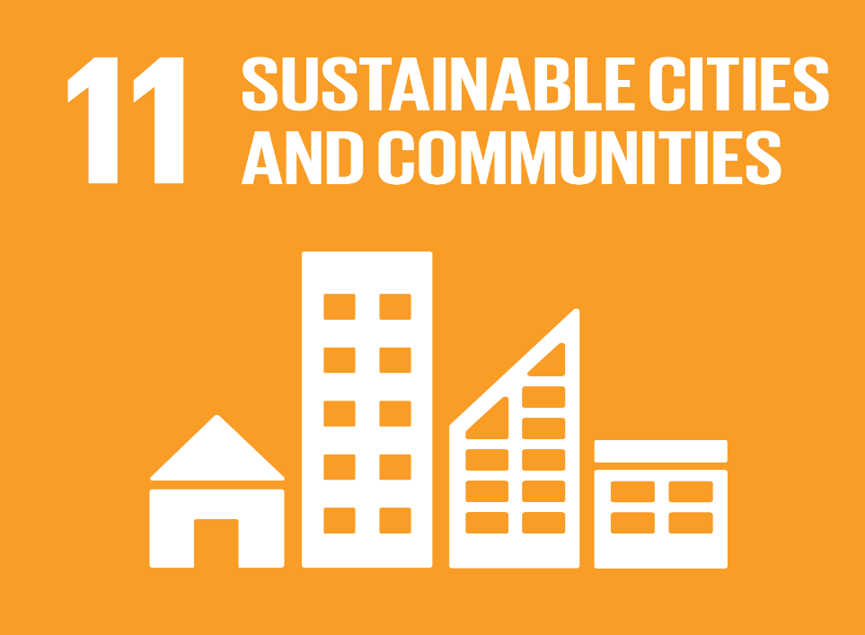


Goal 11: Sustainable Cities and Communities
Sustainable Development Goals
It stives to mitigate the negative consequences of natural catastrophes like typhoons.
Goal 13: Climate Action
It stives to take immediate action to address climate change and its consequences.
Goal 15: Life on Land
It seeks to manage forest sustainability, prevent desertification, halt and reverse land degradation, and halt biodiversity loss.

Slide 3
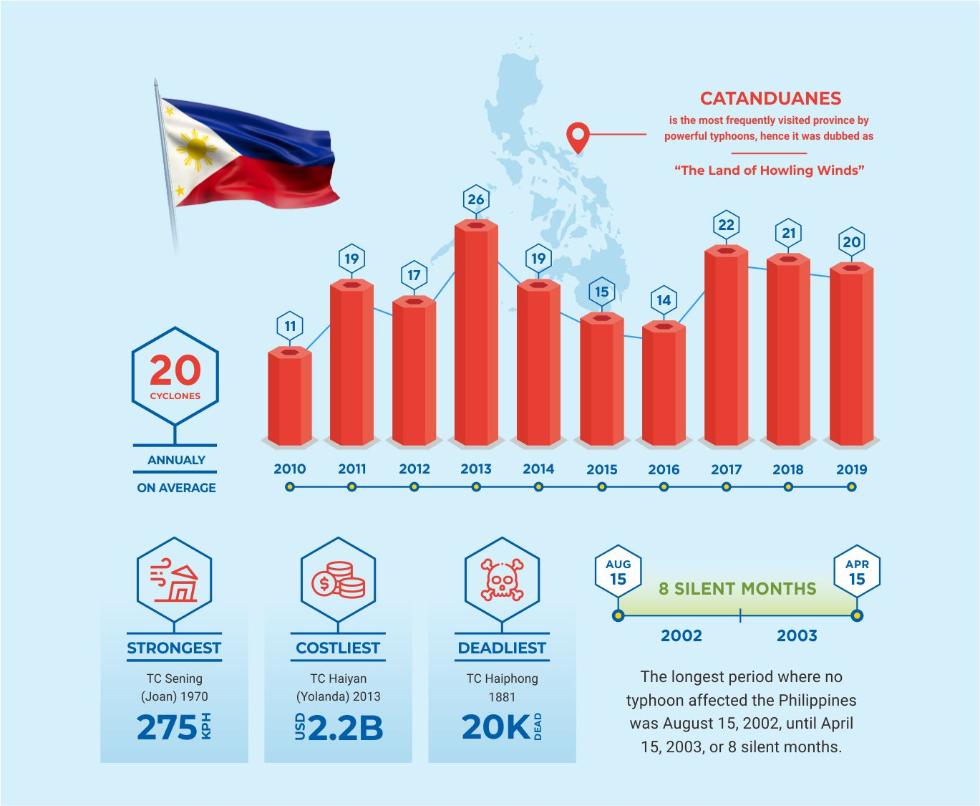
DID YOU KNOW?
- Approximately, Twenty tropical cyclones pass through the Philippine Area of Responsibility per year (Brown, 2013).
- Insufficient public awareness of storm surges caused higher casualties Tacloban city. (Commision on Audit, n.d.).
“Experience is a master teacher, even when it’s not our own.” ― Gina Greenlee

Slide 4

PROBLEM STATEMENT
The primary issue addressed by this project is the lack of a mitigation and response framework among the cities and municipalities located throughout the Philippine archipelago.

Slide 5
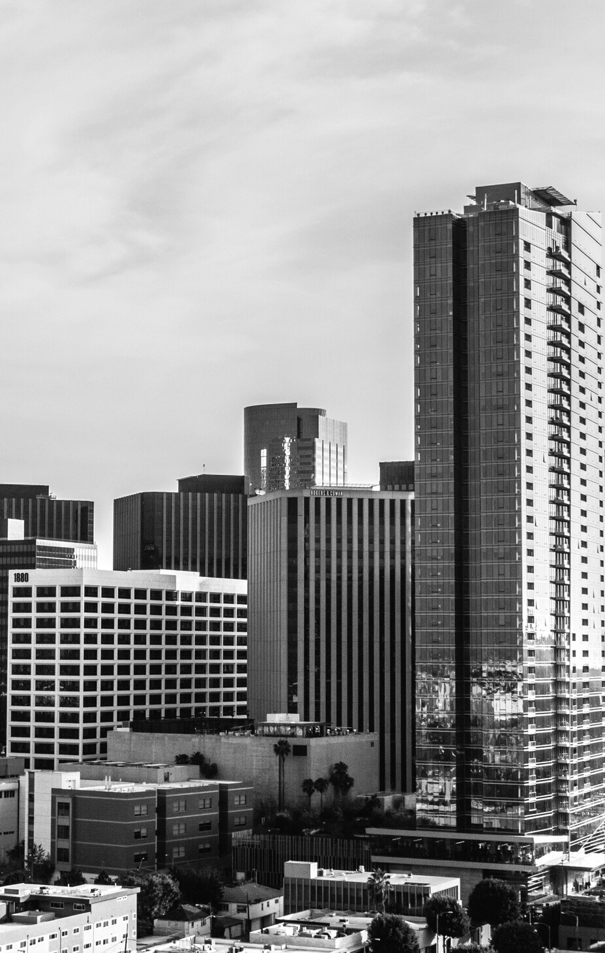


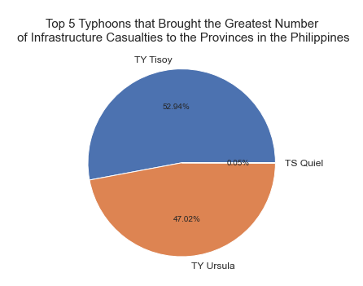
TYPHOON TISOY
Typhoon Tisoy has the most destructive impact on the houses in every region in the Philippines from 2019 with a 68,104 in number. While TY Ursula has the second highest number with 60,483 housing damaged. Why did this happened?
68,104
TYPHOON TISOY TYPHOON URSULA
TYPHOON QUIEL
Totally Damaged Houses
Notes:
A recent Harvard research found that despite the fact that the Philippines is one of the most disaster-prone nations in the world, the majority of Filipino households feel unprepared for catastrophes and natural hazards due to a lack of financial resources. In 2017, Harvard Humanitarian Initiative (HHI) DisasterNet Philippines conducted the first survey of its type to gauge household preparation for disasters, reaching 4,368 families around the country (Enano, 2019). According to the survey report, just 36% of respondents felt completely prepared for disasters, while 33% reported being moderately prepared. The other third of respondents reported to be just minimally or not at all prepared for natural disasters such as typhoons, earthquakes, floods, and landslides. Over nine million Filipinos have been impacted by a natural catastrophe in the previous five years, according to the HHI. However, over 47 percent of respondents indicated they had made no preparations for these disasters. Despite the fact that the majority of respondents claimed to have discussed emergency preparations with family members, the majority do not have "go bags" or emergency bags or even first aid kits, according to the survey.

Slide 6
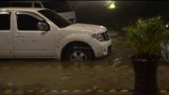

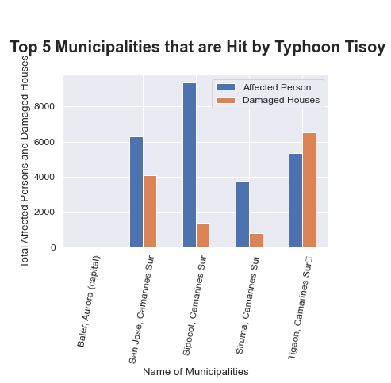
SIPOCOT, CAMARINES SUR
TYPHOON TISOY TYPHOON URSULA
TYPHOON QUIEL
136.0
Totally Damaged Houses
Source: Earth Uncut TV (2019)
Notes:
From the graph above, it can be concluded that most of the municipalities who were greatly affected by Typhoon Tisoy is from Camarines Sur, Bicol Region. These municipalities includes San Jose, Sipocol, Sinuma, and Tigaon.
In the aftermath of Typhoon Tisoy, the Bicol area (Region 5) was hit particularly severely, with over 1,200,000 people impacted and over 256,000 homes damaged or destroyed. According to 2018 data, 27 percent of Bicol's population lives below the poverty line, and its primary economic activities include fishing and farming. Prior to Typhoon Tisoy, there were significant risks among the affected population, notably among low-income households dwelling in high-risk regions and in buildings built of lightweight materials (Humanitarian Country Team, 2019). The region's geographic location renders it susceptible to natural disasters, and several regions of the region were affected by Typhoon Nina in 2017 and Typhoon Usman in 2018, prompting the communities to create emergency planning and response plans that rely largely on their own resources.

Slide 7
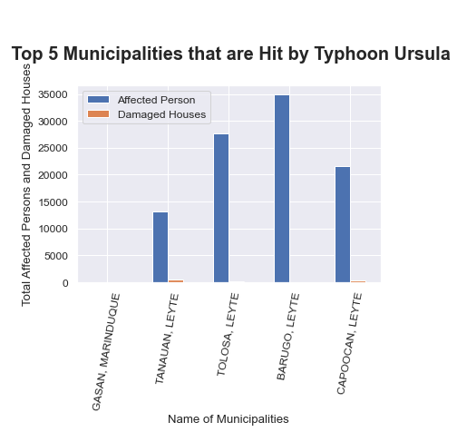


Barugo, Leyte
34932.0
TYPHOON URSULA
Barugo, Leyte
Total Affected Persons
Most affected Municipality

Slide 8
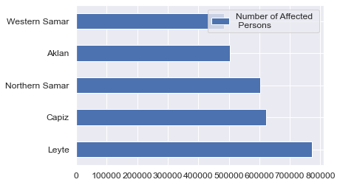


OBJECTIVES
Humanitarian Data Exchange Data set about Philippines (2019)
Objective 1
Objective 2
Objective 3
The Centre for Research on the Epidemiology of Disasters' Data set about the American Typhoons (2000-2022)
LEYTE
WESTERN SAMAR
772162.0
483308.0
AFFECTED INDIVIDUALS
AFFECTED INDIVIDUALS

Slide 9
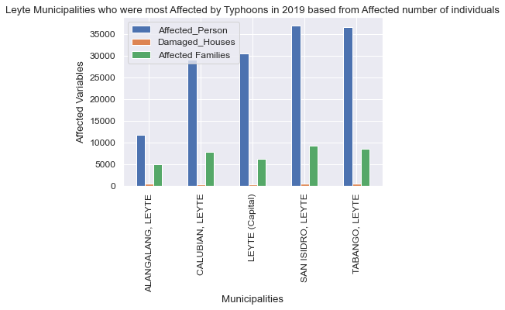
OBJECTIVES
Humanitarian Data Exchange Data set about Philippines (2019)
Objective 1
Objective 2
Objective 3
The Centre for Research on the Epidemiology of Disasters' Data set about the American Typhoons (2000-2022)
SAN, ISIDRO, LEYTE
ALANGALANG, LEYTE
36980.0
11680.0
AFFECTED INDIVIDUALS
AFFECTED INDIVIDUALS

Slide 10
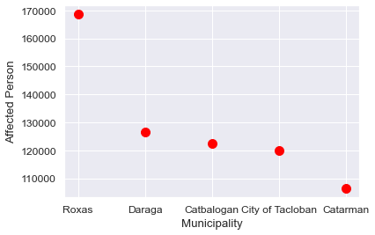
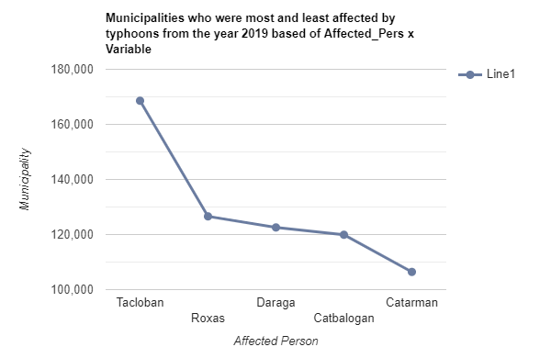
OBJECTIVES
Humanitarian Data Exchange Data set about Philippines (2019)
Objective 1
Objective 2
Objective 3
The Centre for Research on the Epidemiology of Disasters' Data set about the American Typhoons (2000-2022)
TOP 5
MUNICIPALITIES
Who had the most affected individuals in the year 2019

Slide 11
OBJECTIVES
Humanitarian Data Exchange Data set about Philippines (2019)
The Centre for Research on the Epidemiology of Disasters' Data set about the American Typhoons (2000-2022)
Objective 1
Objective 2
Objective 3
Objective 4
Objective 5

Slide 12
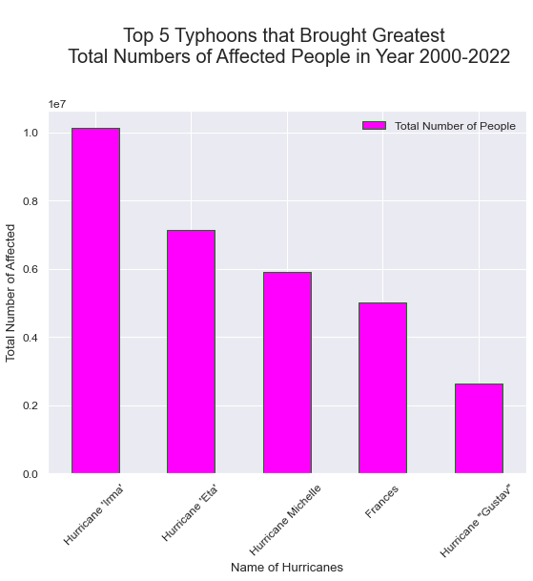
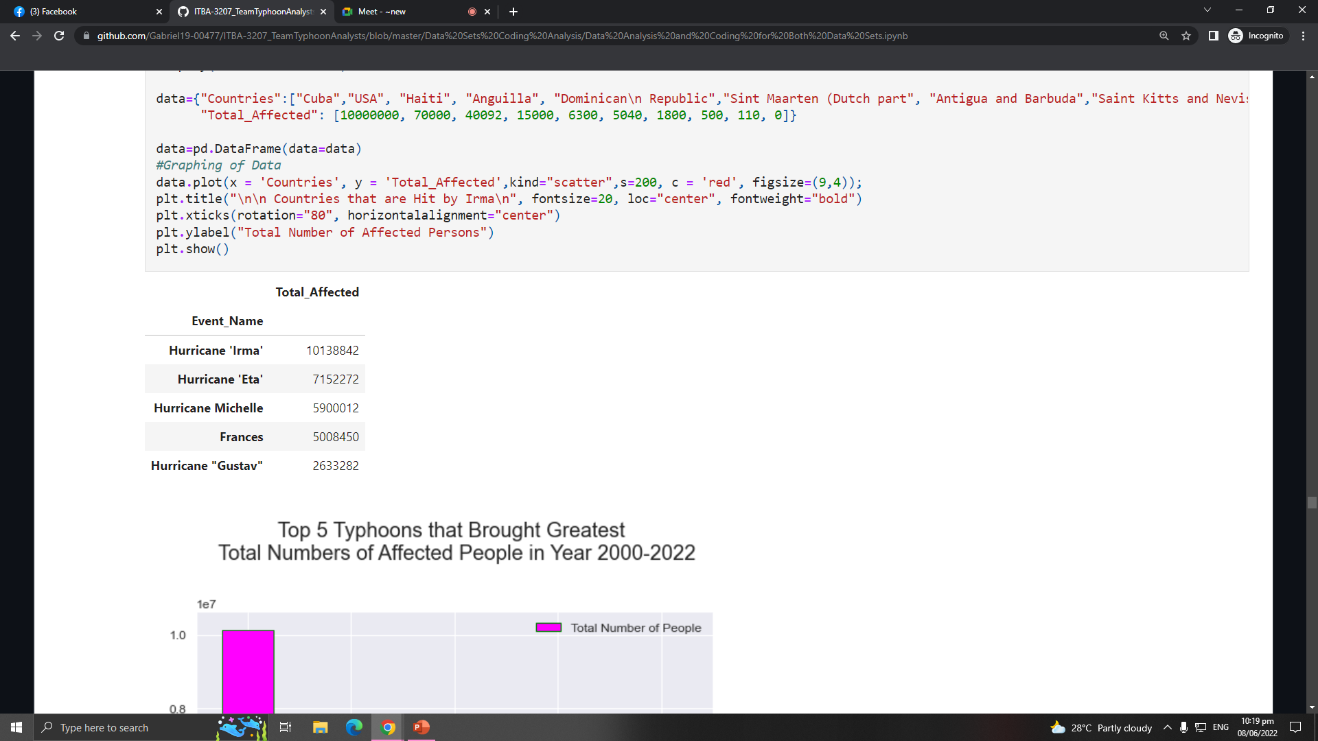

OBJECTIVES
Humanitarian Data Exchange Data set about Philippines (2019)
The Centre for Research on the Epidemiology of Disasters' Data set about the American Typhoons (2000-2022)
Objective 1
Objective 2
Objective 3
Objective 4
Objective 5
HURRICANE
IRMA

Slide 13
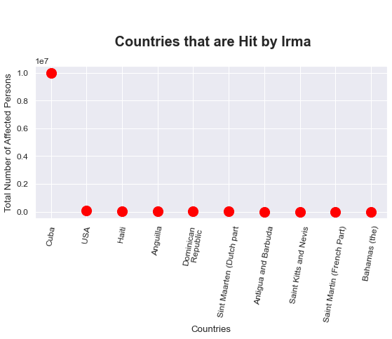
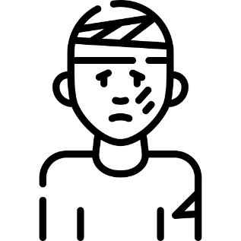
OBJECTIVES
Humanitarian Data Exchange Data set about Philippines (2019)
The Centre for Research on the Epidemiology of Disasters' Data set about the American Typhoons (2000-2022)
Objective 1
Objective 2
Objective 3
Objective 4
Objective 5
10M
HURRICANE IRMA
TOTAL AFFECTED PERSON IN CUBA BY THE HURRICANE IRMA

Slide 14
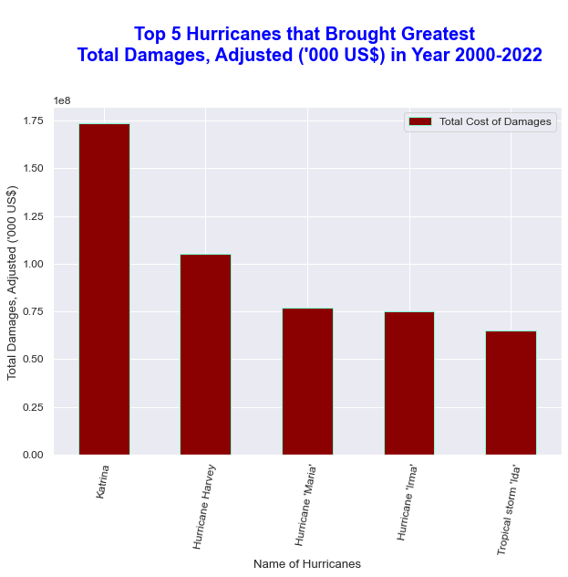
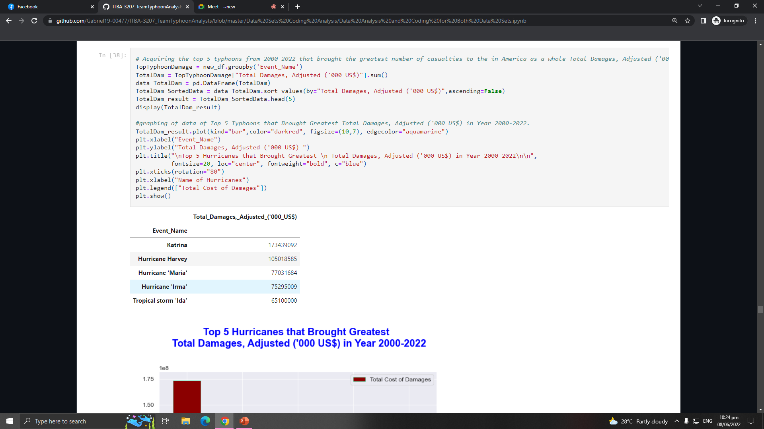
OBJECTIVES
Humanitarian Data Exchange Data set about Philippines (2019)
The Centre for Research on the Epidemiology of Disasters' Data set about the American Typhoons (2000-2022)
Objective 1
Objective 2
Objective 3
Objective 4
Objective 5
HURRICANE
KATRINA

Slide 15
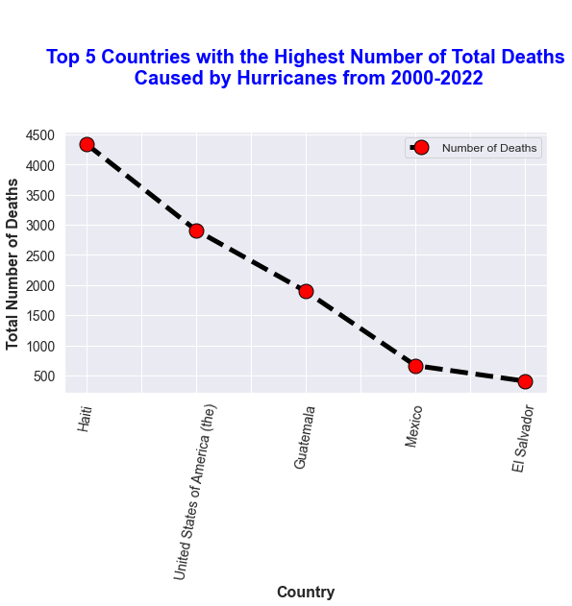
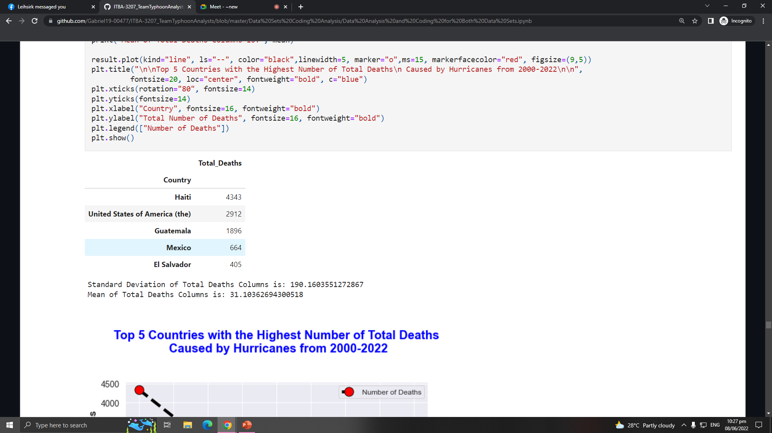
OBJECTIVES
Humanitarian Data Exchange Data set about Philippines (2019)
The Centre for Research on the Epidemiology of Disasters' Data set about the American Typhoons (2000-2022)
Objective 1
Objective 2
Objective 3
Objective 4
Objective 5
HAITI
4343
TOTAL DEATHS

Slide 16
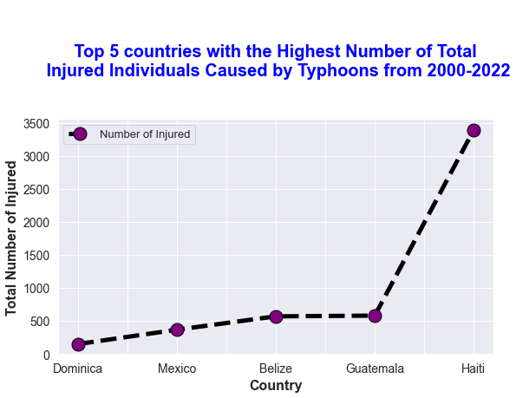
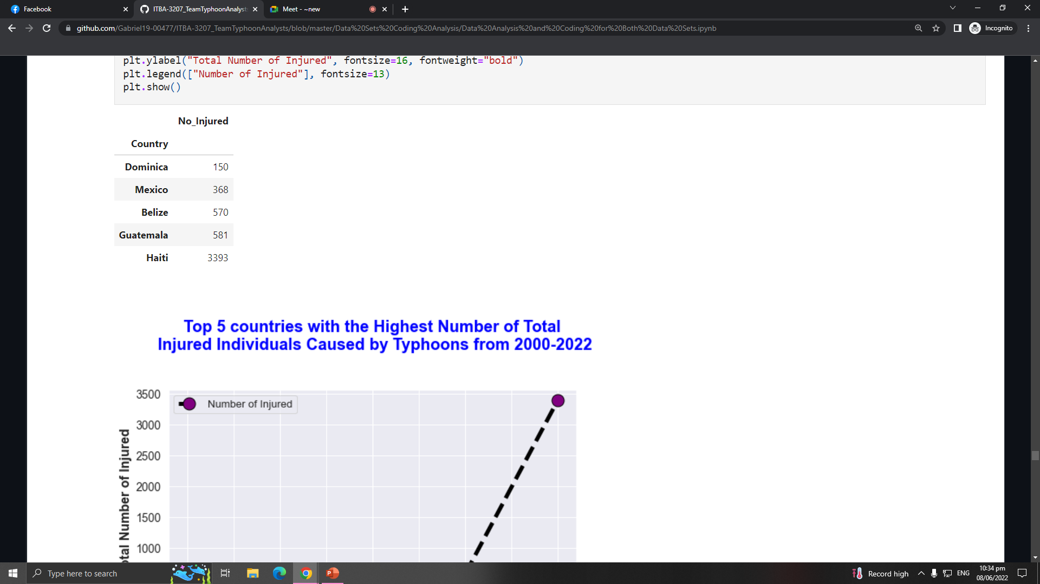

OBJECTIVES
Humanitarian Data Exchange Data set about Philippines (2019)
The Centre for Research on the Epidemiology of Disasters' Data set about the American Typhoons (2000-2022)
Objective 1
Objective 2
Objective 3
Objective 4
Objective 5
3393
150
NUMBER OF INJURED IN HAITI
NUMBER OF INJURED IN DOMINICA

Slide 17
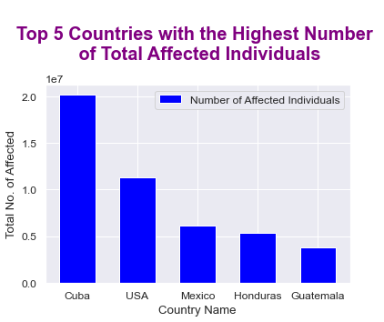
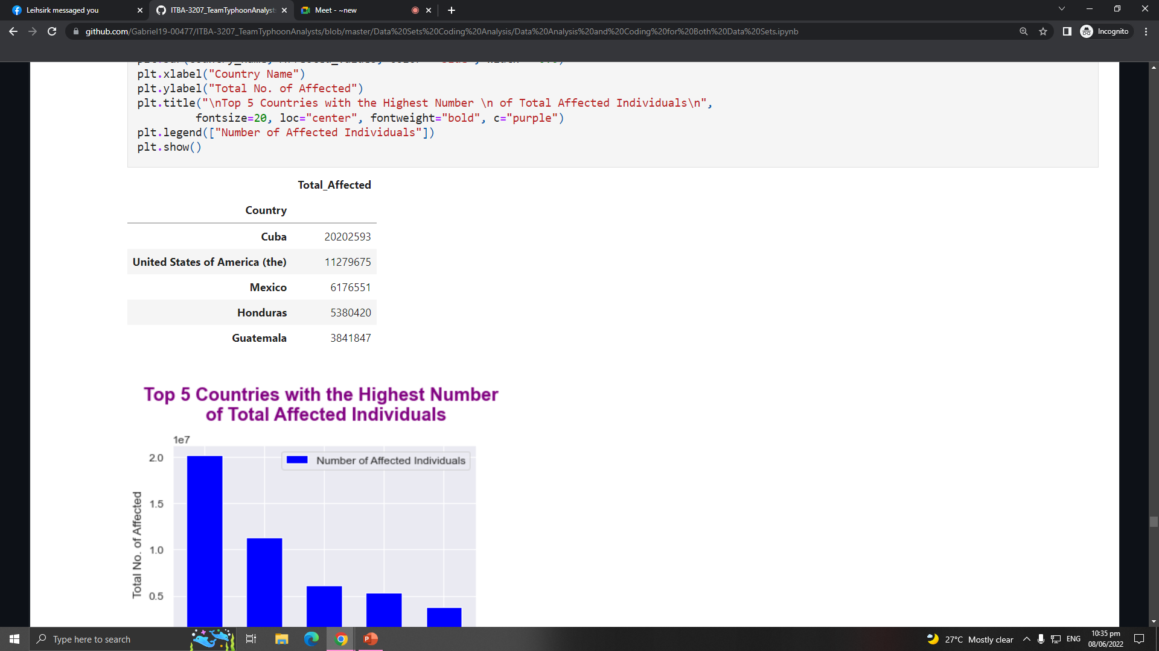
OBJECTIVES
Humanitarian Data Exchange Data set about Philippines (2019)
The Centre for Research on the Epidemiology of Disasters' Data set about the American Typhoons (2000-2022)
Objective 1
Objective 2
Objective 3
Objective 4
Objective 5
20202593.0
TOTAL AFFECTED INDIVIDUALS IN CUBA

Slide 18
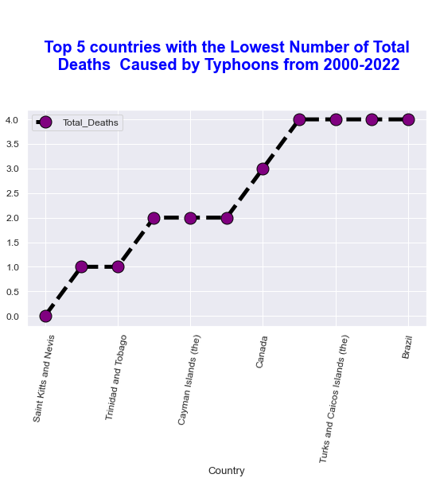
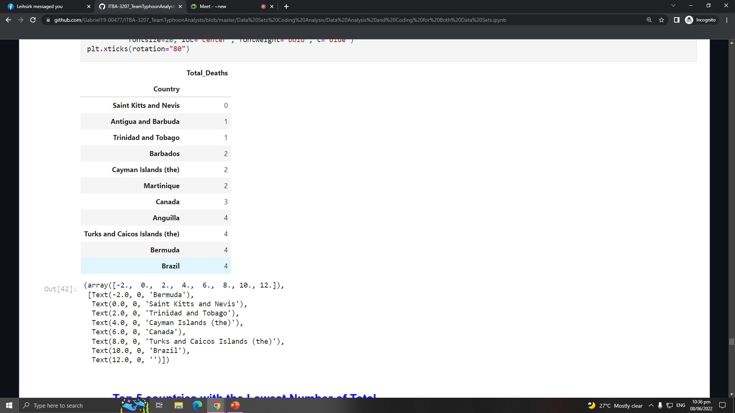
OBJECTIVES
Humanitarian Data Exchange Data set about Philippines (2019)
The Centre for Research on the Epidemiology of Disasters' Data set about the American Typhoons (2000-2022)
Objective 1
Objective 2
Objective 3
Objective 4
Objective 5
Saint Kitts and Nevis
Lowest Number of Total Deaths

Slide 19
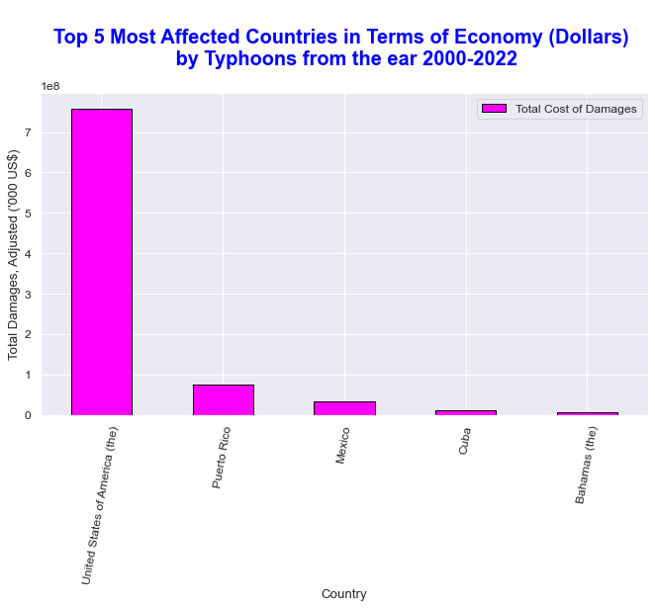
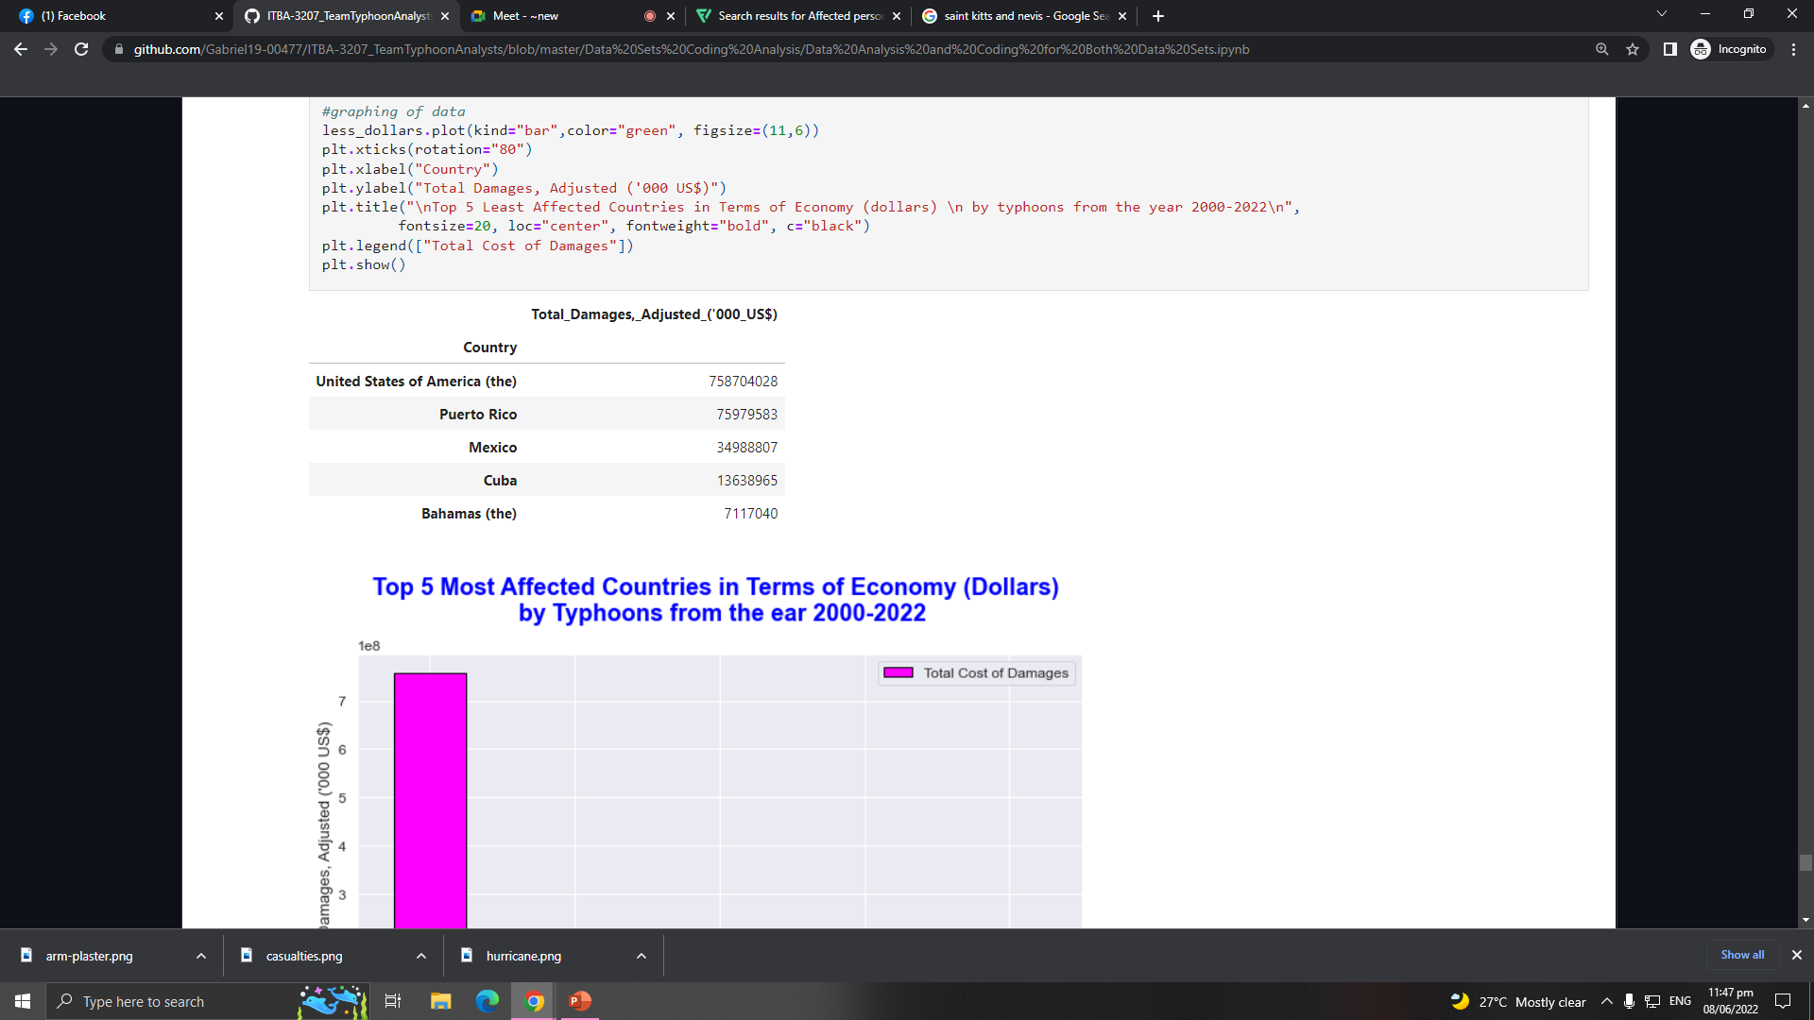
OBJECTIVES
Humanitarian Data Exchange Data set about Philippines (2019)
The Centre for Research on the Epidemiology of Disasters' Data set about the American Typhoons (2000-2022)
Objective 1
Objective 2
Objective 3
Objective 4
Objective 5
USA
MOST AFFECTED COUNTRY HAVING MORE THAN 700 BILLION TOTAL COST OF DAMAGES

Slide 20
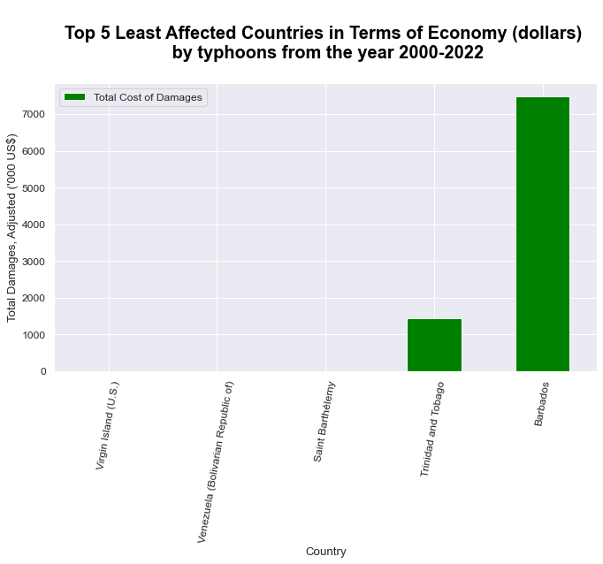
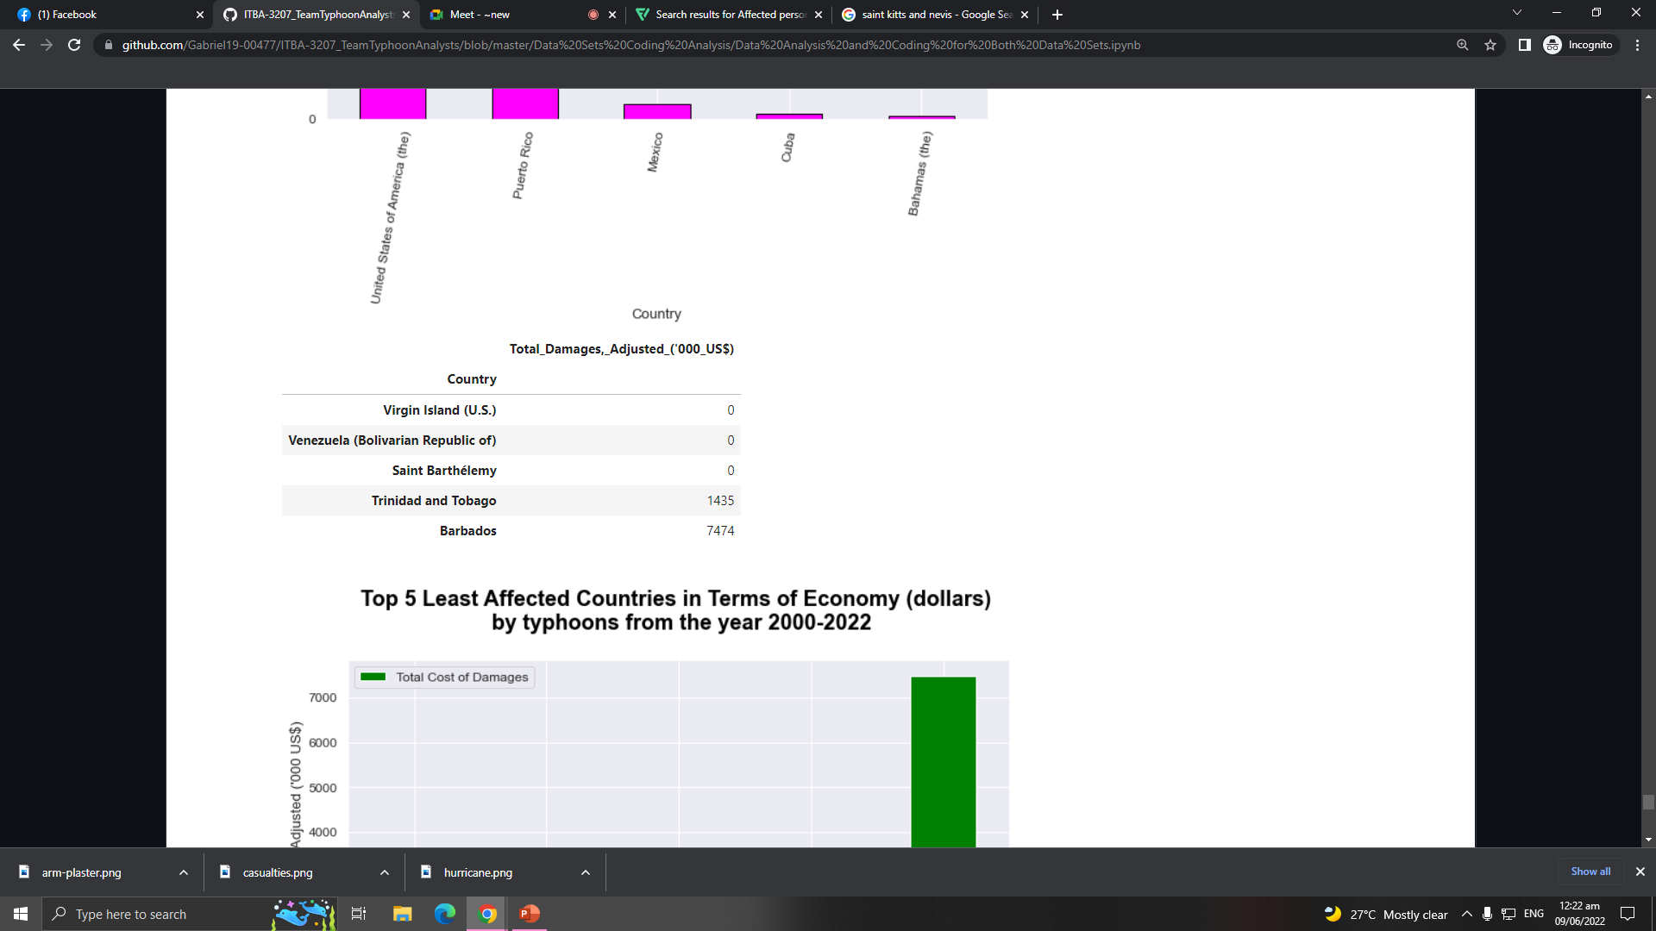
OBJECTIVES
Humanitarian Data Exchange Data set about Philippines (2019)
The Centre for Research on the Epidemiology of Disasters' Data set about the American Typhoons (2000-2022)
Objective 1
Objective 2
Objective 3
Objective 4
Objective 5
Virgin Islands, Venezuela, and Saint Barthelemy
No Record of Total Cost of Damages

Slide 21
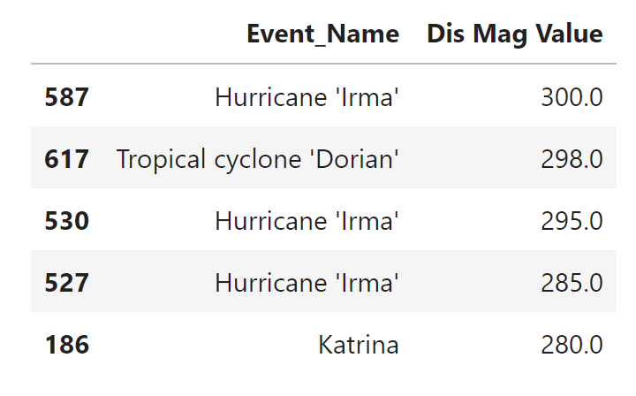
OBJECTIVES
Humanitarian Data Exchange Data set about Philippines (2019)
The Centre for Research on the Epidemiology of Disasters' Data set about the American Typhoons (2000-2022)
Objective 1
Objective 2
Objective 3
Objective 4
Objective 5

Slide 22


Source of Datasets
HDX
An open platform for sharing data across crises and organizations and goal of it to make humanitarian data easy to find and use for analysis.
CRED
The Centre promotes research, training and technical expertise on humanitarian emergencies, particularly in public health and epidemiology.

Slide 24




MEET THE TEAM
TEAM TYPHOON ANALYST
Gabriel Alvaro
Project Manager
John Palis
Presentation Manager
Christine Alangilan
Documentation Director
Marian Guerra
Quality Assurance Analyst

